Slide 1
Toxoplasmosis

Slide 2
Clinical Presentation
Patient is a 29 year-old woman from South America, Goiania-GO, Brazil. At the moment of reporting, the patients reports to be on her second trimester of pregnancy. Admitted at Goiania Gastrico hospital, the patient reported having flu like symptoms including headache, fever, muscle aches, and drowsiness.
On physical examination, mental status changes are observed which includes seizure, alteration of consciousness, and cranial nerve palsies. The patient reports her preference for meat and admits domesticating a cat which occasionally defecates within the household.
Blood sample was taken and tested for IgG antibodies which tested positive showing possibility of past or current toxoplasmosis infection.

Slide 3
Clinical Presentation Contd’
Further test of IgM antibodies was done establishing that the infection is a current one and occurred after 16 weeks of pregnancy.
Amniocentesis –technique where amniotic fluid is removed from the amniotic sac- was done and the baby tested negative. The patient was given a combination of pyrimethamine and sulfadiazine and folinic acid to be taken for 4 to 6 weeks.
The patient was continually evaluated, and she reported disappearance of the symptoms after 4 weeks of treatment. The hospital visits, however, continues to assess the patient and the unborn’s condition.

Slide 4
What is Toxoplasmosis
Toxoplasmosis is a parasitic disease caused by one of the world’s most common parasites, Toxoplasma gondii.
The parasites causes infection when one; eats undercooked meat, drinks contaminated water, is exposed to infected cat feces, or when a child contracts the parasite from the mother during pregnancy.
Also, though very rare, one can contract the parasite by receiving infected organ or blood during transplant and transfusion, respectively.
Whereas Toxoplasmosis does not show distinct symptoms in several people it affects, it may often cause flu-like symptoms.
It may cause serious complications to pregnant women and immunocompromised patients, however.

Slide 5
Toxoplasma gondii and how it causes Toxoplasmosis
Toxoplasma gondii is a protozoic parasite
It infests most warm blooded animals
Its primary host are members of the cat family
Oocyst sporulate after excretion and become infective.
When humans ingest the toxoplasma gondii through any of the routes earlier stated, the parasite penetrates intestinal wall consequently invading body cells.
It forms tissue cysts, majorly in the skeletal muscle, brain, eyes, and myocardium.
For individuals in a healthy state, the cysts may remain in their body in an inactive form for their entire life. However, for individuals with weakened immune system, the infection can lead to severe complications.
Its virulence and infectivity not only depends on the parasites genotypes, but also factors controlling parasite-host cell interaction or the host immune response.

Slide 6
Clinical Manifestation
Signs and Symptoms of Toxoplasmosis
Reinstated, a significant number of infected individuals does not show signs and symptoms.
Some people, however, show flu like symptoms, and muscle aches, or swollen lymph glands lasting for a month or more.
When severe, the infection can cause damage to eyes, brain, or other organs. Occasionally, the infections becomes severe if it’s either reoccurring in a person or the individual has compromised immune system.
Notably, majority of infants infected while in the womb shows no signs of the disease, however, they develop them at their teens or a later stage in life.

Slide 7
Clinical Manifestation Cont.
Congenital Toxoplasmosis
Seizures
Enlarged liver and spleen
Severe eye infections
Jaundice
Ocular Toxoplasmosis
Reduced vision
Pain
Redness of the eye
Tearing of the eye
Severe Toxoplasmosis
Headache
Confusion
Poor coordination
Seizures
Lung problems

Slide 8
Initial Diagnosis
Often, Toxoplasmosis is difficult to diagnose because it is asymptomatic, and when it presents signs and symptoms, they are similar to mononucleosis and flu symptoms.
The common diagnostic method is the serologic testing.
Misdiagnosis, particularly false-positive, can create a false perception that one has been immunized against the infection and, therefore, stop preventive measures.
  On the surface, this increasing risks to the infection.
Through continuous research over the recent years, researchers have developed the testing kits accuracy.
For instance, a study on Toxo IgG assay by Abbot Laboratories in North Chicago showed sensitivities and specifities ranging from 92.1% to 99.7% and 99.1% to 99.85, respectively.

Slide 9
Diagnostic Tests
Diagnosis of toxoplasmosis can be highlighted as:
  Presence of parasites in a patient’s specimen
  Health provider isolating parasite from blood or other body fluids through inoculation or tissue culture. When inoculated in a mice, the mice should be tested 6 to 10 days post inoculation for presence of Toxoplasma organism in its peritoneal fluid. Should the results be negative, serology to be performed 4 to 6 weeks post inoculation.
  For detecting congenital infection in the utero, PCR genetic material test to be used.
Toxoplasma-specific antibodies detection is the primary diagnosis of toxoplasma infection; the most commonly tested antibodies are the IgM and IgG antibodies.

Slide 10
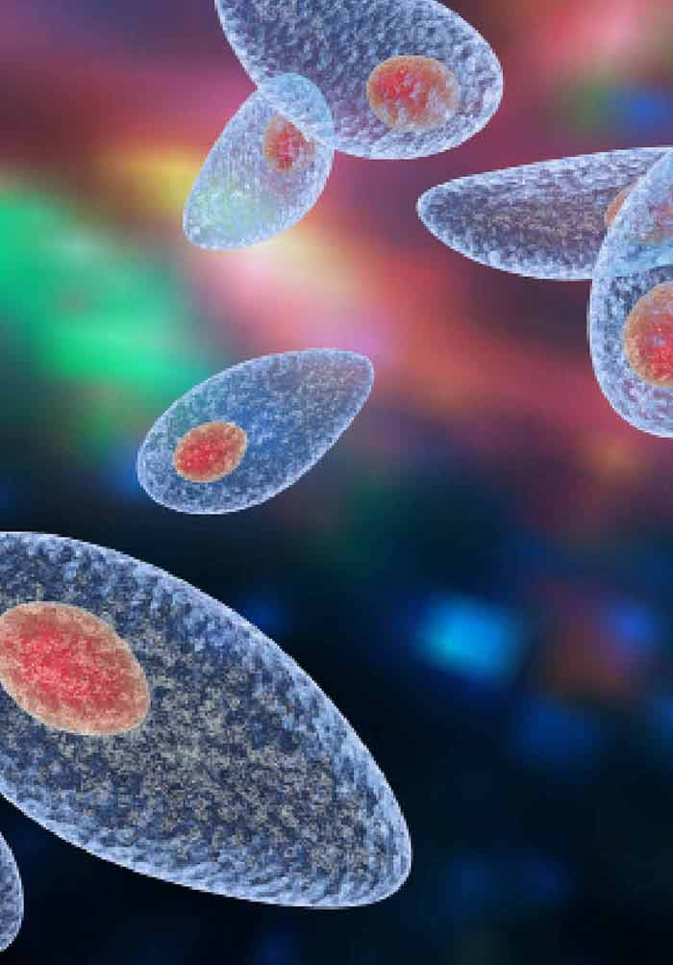
Laboratory Tests
Serologic testing where blood serum is checked for antibodies formed after Toxoplasmosis infection
Biopsy - Observation of the parasite in stained tissues
Separation of parasite from blood – this technique takes a l ot of time and is rarely used
Molecular techniques identify presence of parasite in omniotic fluid in the case of a pregnant woman
Lesions in the eye may signify presence ocular disease
Serology test showing Toxoplasma gondii.

Slide 11
Final Diagnosis
The tests is done by several laboratories using commercial kits. The specificity and sensitivity of the kits may widely vary, however.
An individual is first tested for IgG Toxoplasma-specific antibodies to identify their immune status.
In the interpretation, a positive IgG test indicates a previous infection by the toxoplasma organism.
To determine the time of infection, the individual is further subjected to IgM capture EIA, a minimal nonspecific reactions procedure.
Whereas a negative IgM test would mean no recent infection, a positive IgM test would be complicated because IgM antibodies can always be detected by EIA for up to 18 months after acute infection.
Notably, IgG antibodies levels in AIDs patients are low.
Because of difficulty in interpreting tests results, CDC recommends all positive cases be confirmed in Toxoplasmosis specializing laboratory.

Slide 12
Treatment
Majority of healthy individuals recover from toxoplasmosis without treatment.
Notwithstanding, individuals developing complications can be treated with combination of drugs not limited to the following;
  Pyrimethamine (Daraprim)
  Sulfadiazine
  Folinic acid (leucovorin)
  Clindamycin (Cleocin)
Although they can be treated, the parasite may not be eliminated completely in infants, newborns, and pregnant women.

Slide 13
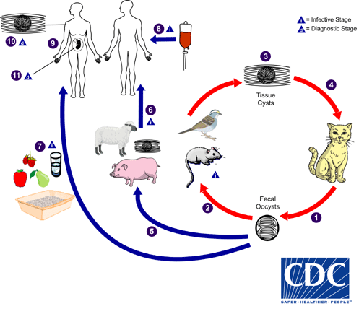
Transmission
Toxoplasma gondii, a parasite only excreted in cat feces, can be transmitted through;
  Eating undercooked animal meat harboring tissue cysts.
  Consuming cat-feces contaminated food or water
  Mother to child during pregnancy
  Infected organ transplant or blood transfusion

Slide 14
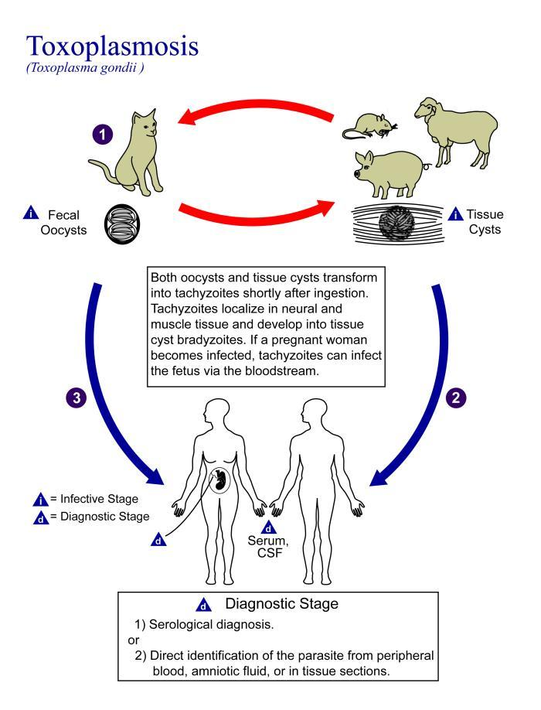
Etiology
Toxoplasmosis is an infection caused by an intracellular protozoan parasite, Toxoplasma gondii, that infects several warm blooded animals, including human beings.
Cat family members are the definitive hosts
Other animals and birds are intermediate hosts
Contact with infested cat feces
Eating undercooked meat
Mother to child during birth

Slide 15
Pathology
The infection is usually asymptomatic in healthy persons.
Approximately 10-20% of individuals with acute infection develops enlarged lymph nodes.
Besides, one may develop headache, fever, and muscle pain.
Immunocompromised patients may develop heart and lung complications. Categorically, AIDs patients may develop lesions in the brain.
Severe illness may result into blindness as sarcocysts in the eye may rapture infected cells.
Congenital infections may result into severe birth defects or stillbirths.

Slide 16
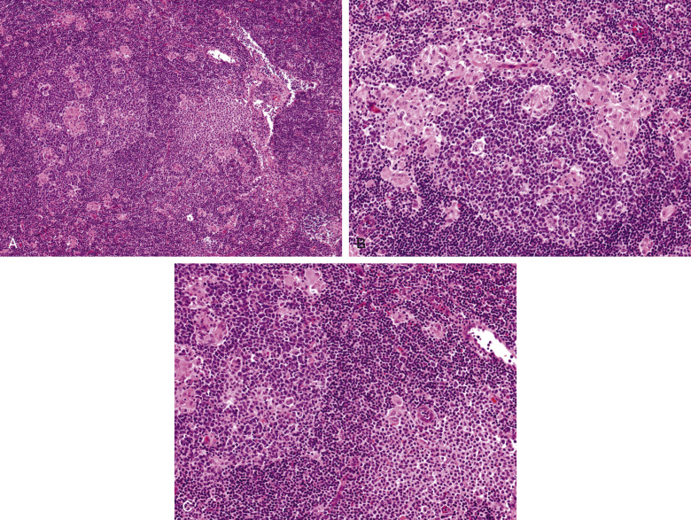
Pathology
A, Low power imaging of reactive follicle with small epithelioid histiocytes clusters around and in follicle centers. B, reactive follicle center surrounded by epithelioid histiocytes clusters. C, epithelioid histiocytes clusters adjacent aggregate monocytoid B cells.

Slide 17
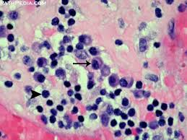
Pathology
toxoplasmosis in immunocompromised individuals such as in HIV+ patients. Shows cerebral cortex and deep grey matter nuclei

Slide 18
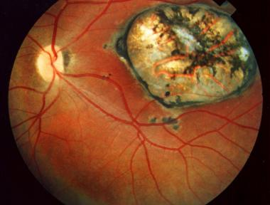
Pathology
Ocular Toxoplasmosis (Inflammation of retina)

Slide 19
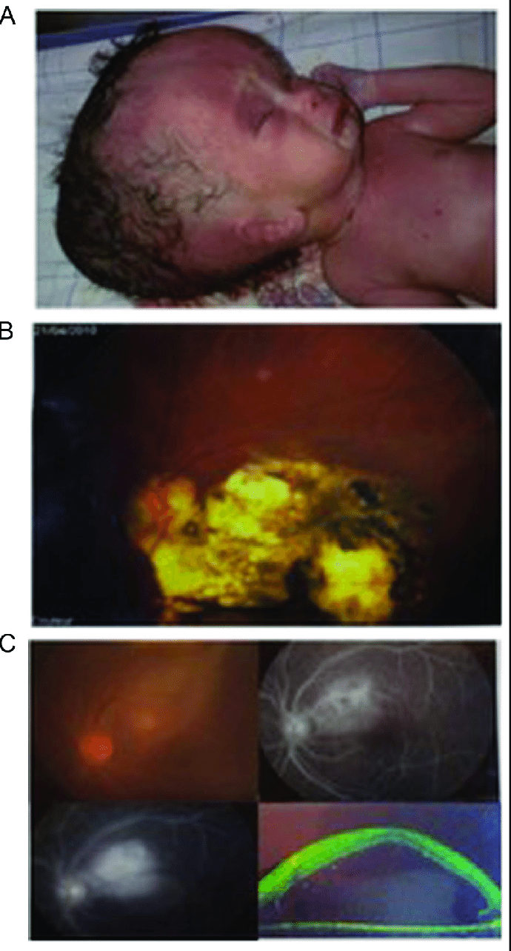
Pathology
congenital Toxoplasmosis

Slide 20
Epidemiology
According to CDC, serologic prevalence data of toxoplasmosis indicates that it is one of the most common infection worldwide.
Worldwide, approximately 30% of human beings are chronically infected with T. gondii.
Seroprevalence can be affected by climatic factors affecting oocysts survival in the environment.
Researchers have related high prevalence in France to high preference for eating raw or undercooked meat.
On the other hand, pieces of research has related high prevalence in Central America to the frequency of stray cats increasing oocysts survival and soil exposure.
Recently, data from NHANES between 2009-2010 depicts that seroprevalence among under 6 years was at 12.4%, whereas among women aged 15-44 years was at 9.1%

Slide 21
Microbiology Characteristics
Organism enters intestinal epithelium
Organism spreads to other host tissues
Individual organisms are lunate, typically measuring 6 X 2 micrometers
Can replicate within all mammalian and avian cells (Black, and Boothroyd, 2000)
Replicates both through feline and nonfeline means
Replicate within cell in a time of approximately 6 hours until they exit to infect neighboring cells
Tissue cysts appear 7 days post-infection

Slide 22
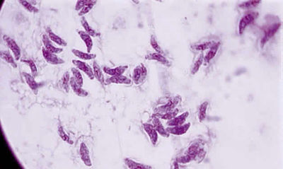
Microbiology Characteristics
Toxoplasmosis gondii magnified 400X

Slide 23
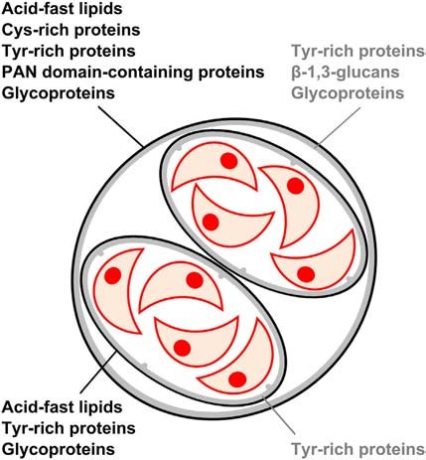
Microbiology Characteristics
Sporulated Toxoplasma

Slide 24
Virulence Factors
Cell interaction factors
Host immune response factors
Genetic dependence
ROP16 and ROP18 proteins on the monocellular blood cells
ROP16 plays a role in the inituial infection
Major tests conducted in mice, action in humans still unclear

Slide 25
References
1 Mayo Clinic, 2020. Toxoplasmosis - Symptoms And Causes. [online] Mayo Clinic. Available at: <https://www.mayoclinic.org/diseases-conditions/toxoplasmosis/symptoms-causes/syc-20356249> [Accessed 3 May 2020].
2. Center for Disease Control and Prevention, 2020. CDC - Toxoplasmosis. [online] Cdc.gov. Available at: <https://www.cdc.gov/parasites/toxoplasmosis/> [Accessed 3 May 2020].
3. Simon, L., Fillaux, J., Guigon, A., Lavergne, R. A., Villard, O., Villena, I., ... & Pomares, C. (2020). Serological diagnosis of Toxoplasma gondii: analysis of false-positive IgG results and implications. Parasite, 27.

Slide 26
References
4. Liu, Q., Wang, Z. D., Huang, S. Y., & Zhu, X. Q. (2015). Diagnosis of toxoplasmosis and typing of Toxoplasma gondii. Parasites & vectors, 8(1), 292.
5. Dubremetz, Jean & Lebrun, Maryse. (2012). Virulence factors of Toxoplasma gondii. Microbes and Infection. 14. 1403-1410. 10.1016/j.micinf.2012.09.005.
6. Robert-Gangneux, F., & Dardé, M. L. (2012). Epidemiology of and Diagnostic Strategies for Toxoplasmosis. Clinical microbiology reviews, 25(2), 264-296. https://cmr.asm.org/content/cmr/25/2/264.full.pdf
7. Torgerson, P. and Mastroiacovo, P., 2013. WHO | The Global Burden Of Congenital Toxoplasmosis: A Systematic Review. [online] Who.int. Available at: <https://www.who.int/bulletin/volumes/91/7/12-111732/en/> [Accessed 4 May 2020].
8. Black, M. W., & Boothroyd, J. C. (2000). Lytic cycle of Toxoplasma gondii. Microbiol. Mol. Biol. Rev., 64(3), 607-623.

